Slide 1

High-Throughput Computing in Atomic Physics
Josh Karpel ⟨karpel@wisc.edu⟩
Graduate Student, Yavuz Group
UW-Madison Physics Department

Slide 2
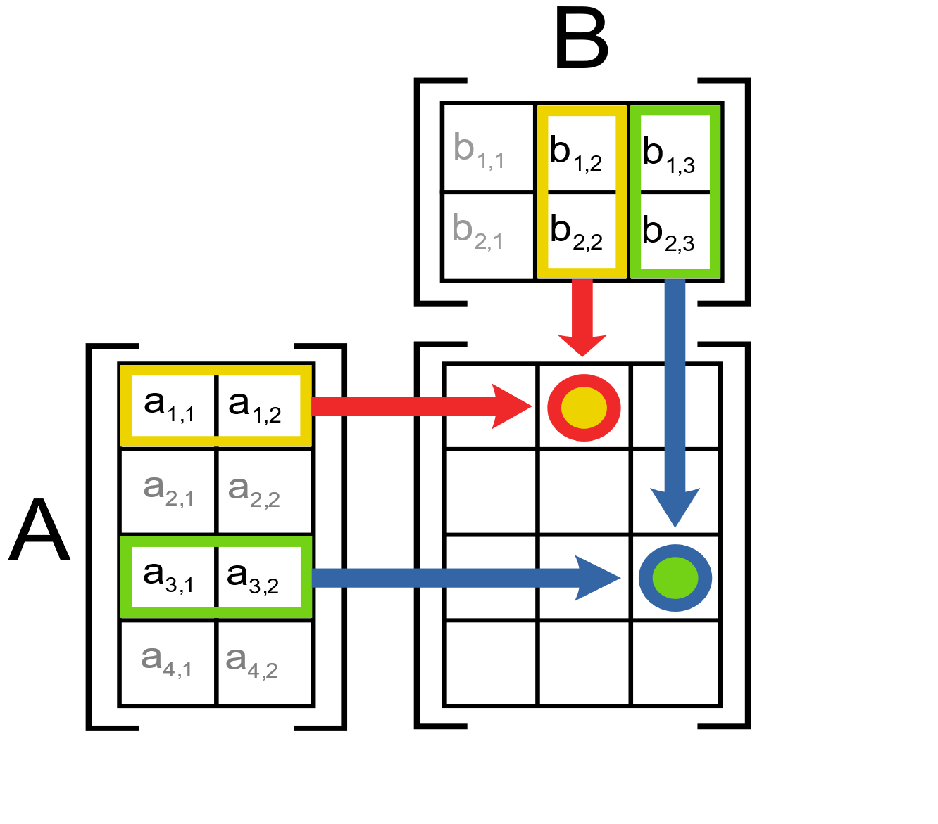

My Research: Matrix Multiplication

Slide 3
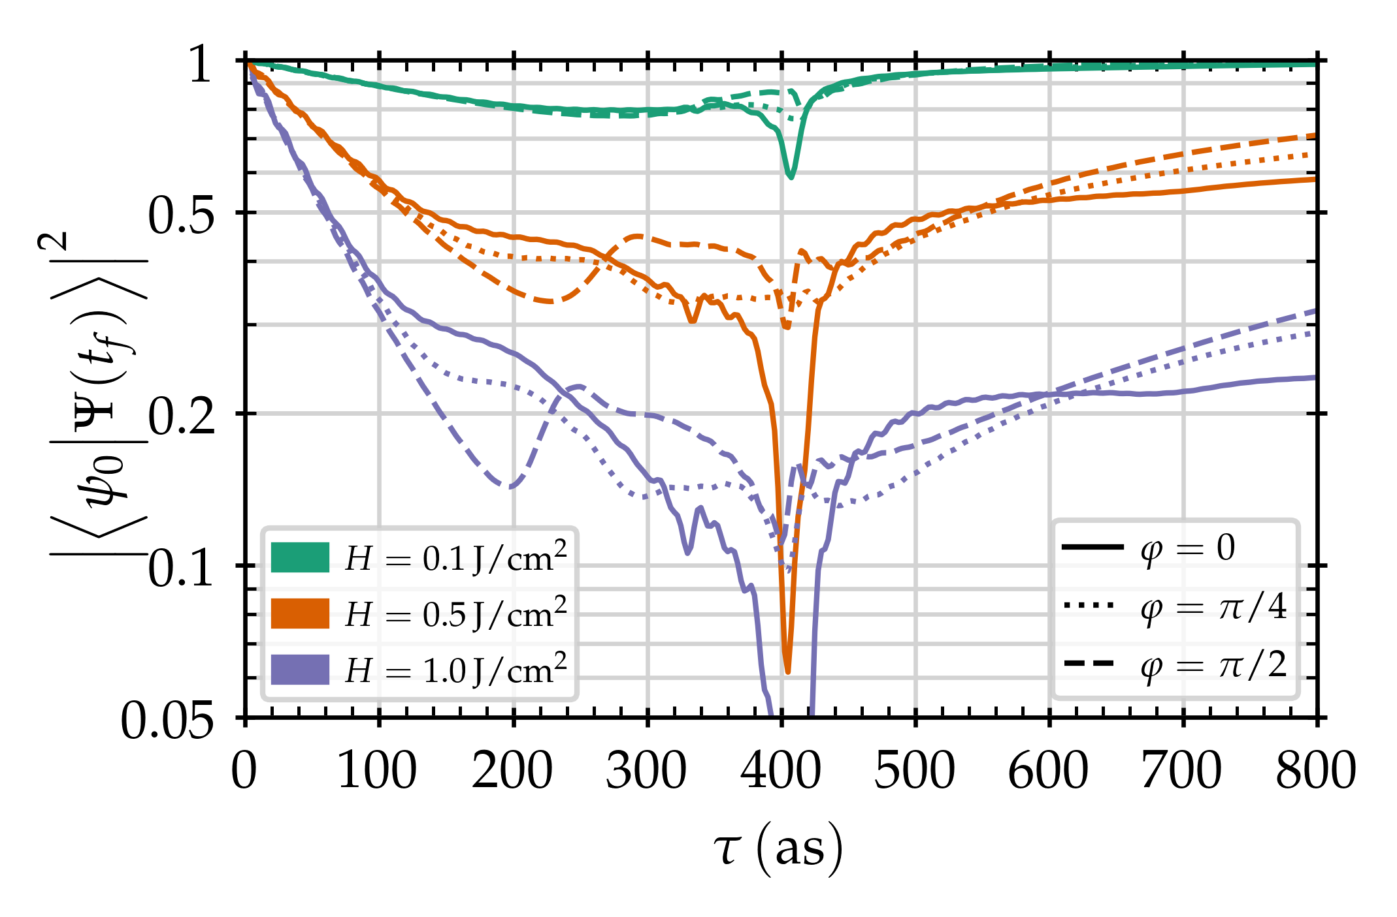
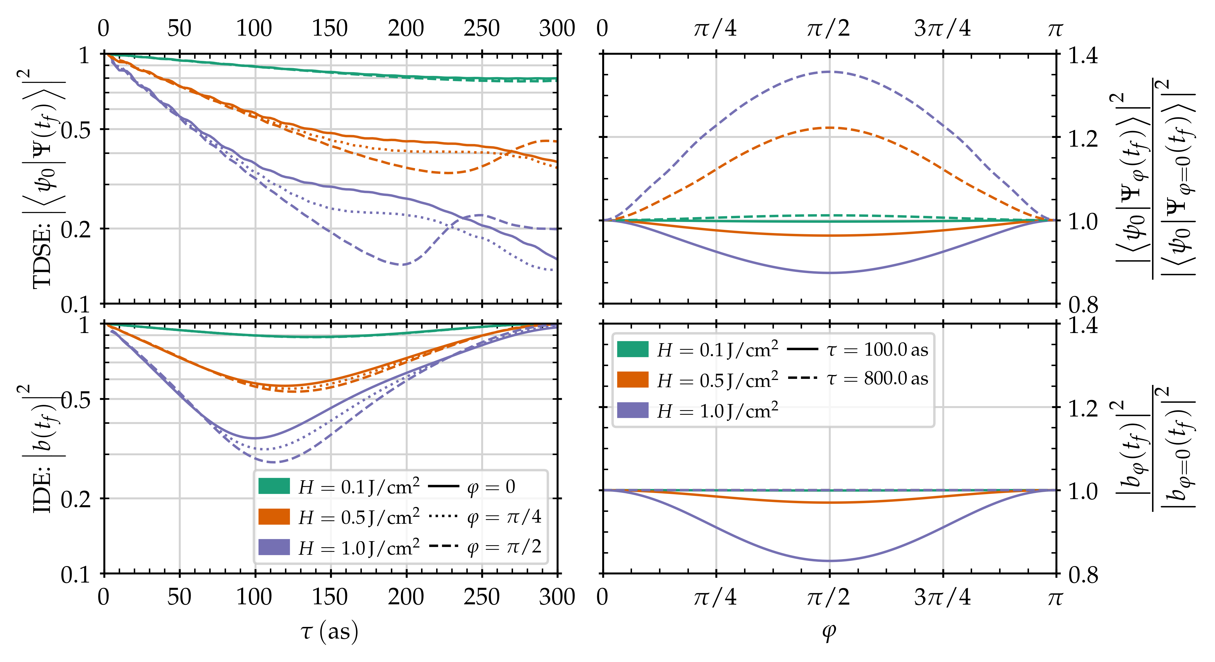
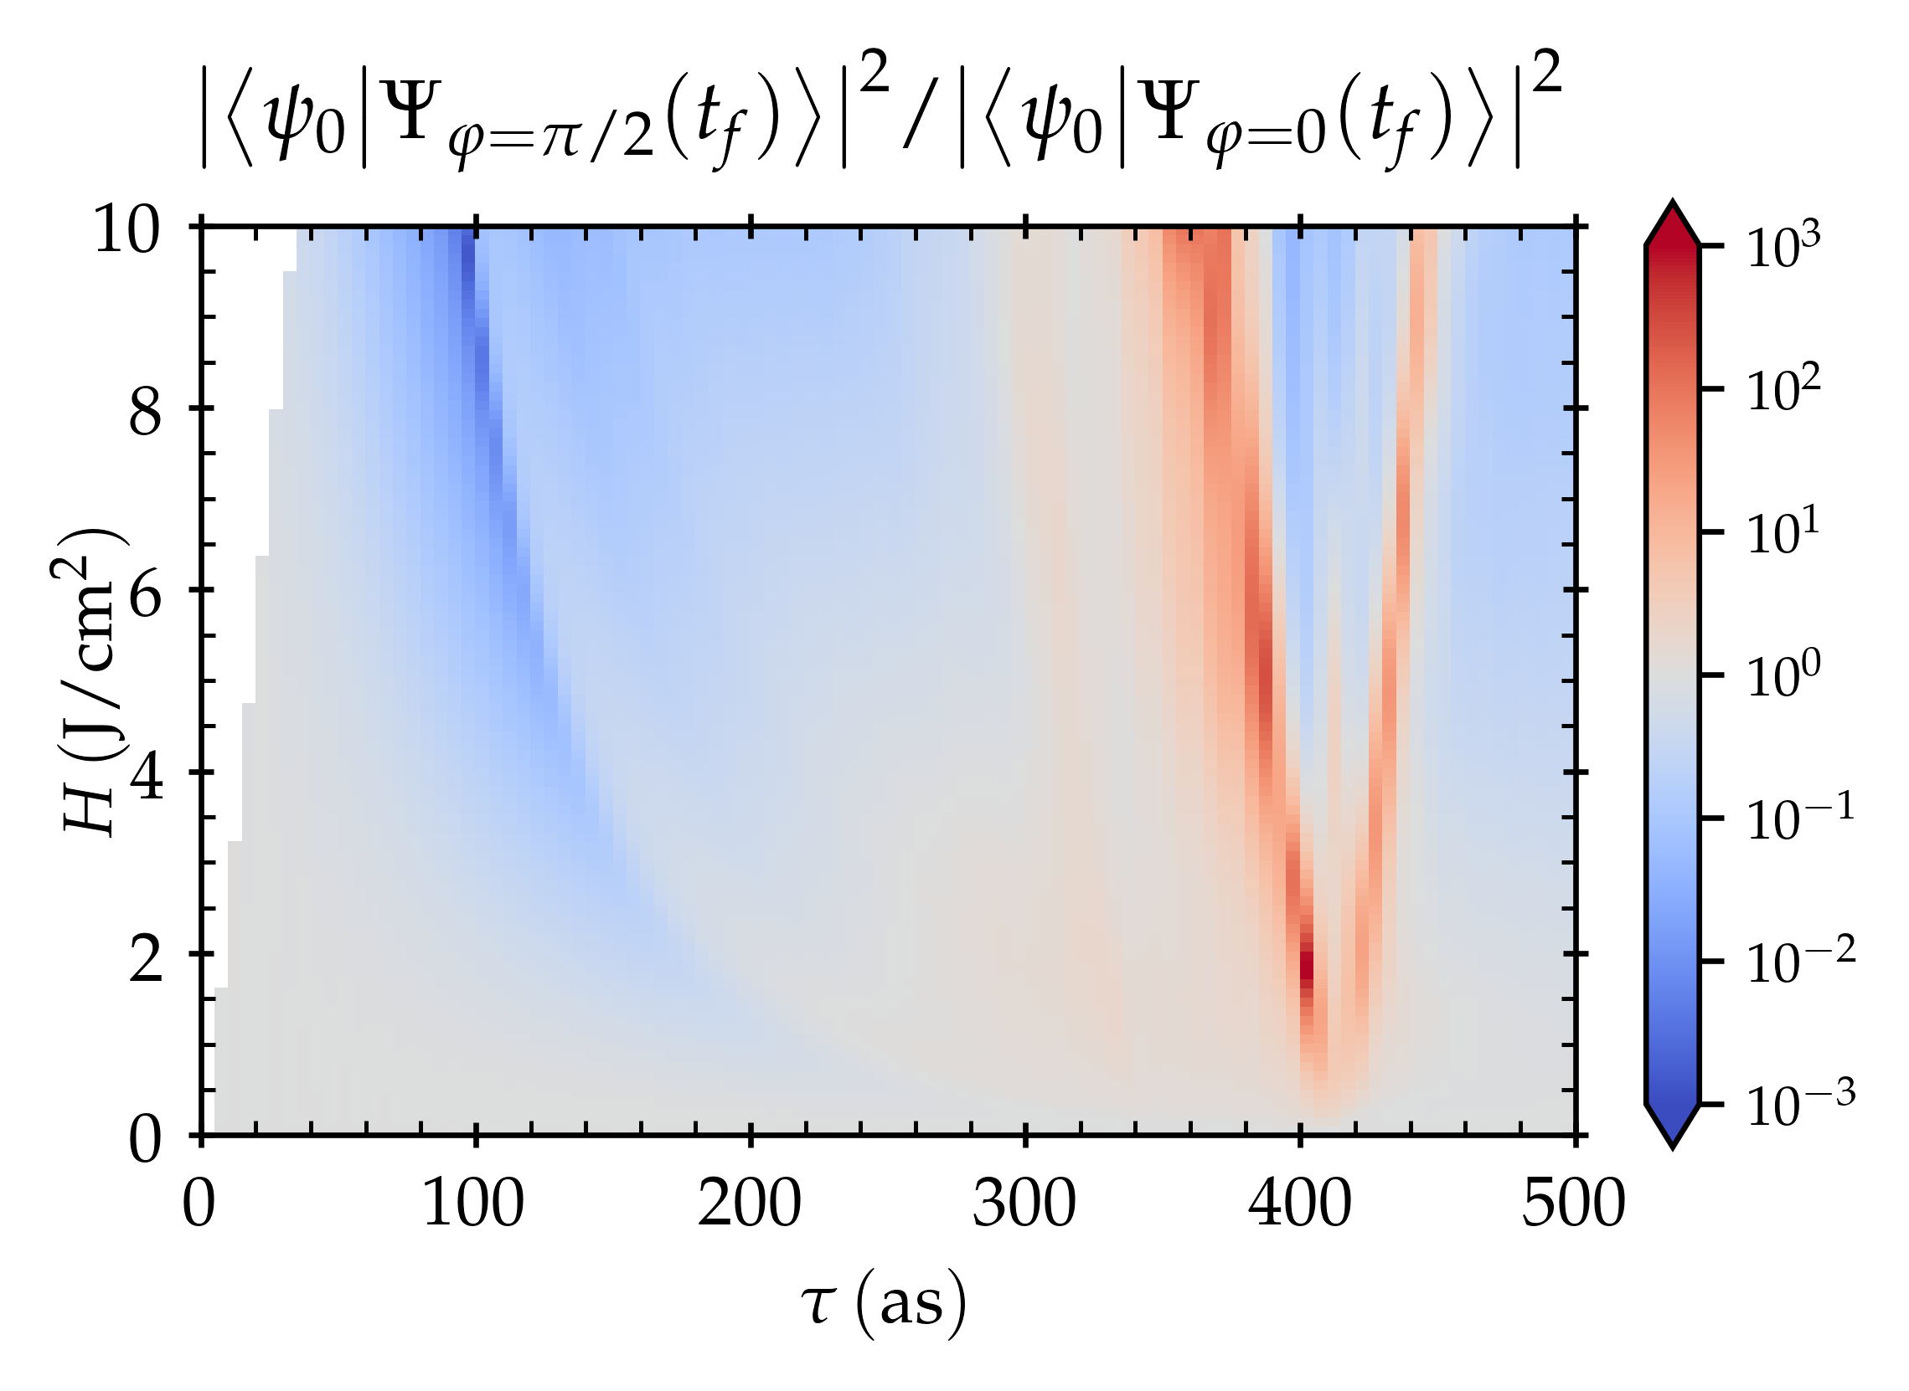
My Research: Computational Quantum Mechanics
Why HTC?
HUGE PARAMETER SCANS
https://doi.org/10.1364/OL.43.002583

Slide 4
Workflows in Atomic/Molecular/Optical Physics
Develop Theory
Simulate Specific Examples
Write Paper
AMO Theory
Simulate Tons of Examples
Develop Theory to Explain Results
Write Paper
What I Do
Chelkowski, S., Bandrauk, A. D., & Corkum, P. B. (2017). https://doi.org/10.1103/PhysRevA.95.053402
Notes:
They’re working in a regime where the lines are straight – I’m not! I need very high resolution to make sure I’m not missing things

Slide 5
The Curse of Ambition
Started out wanting to run
a few hundred hours
Ended up running…
10 million hours, about
1150 years of computing,
in just the last year!
Notes:
I started out running a few dozen hours of simulations on my desktop
Then I wanted to run a few hundreds hours, and needed HTC… and now I’m here

Slide 6
OSG is not a pristine environment
Your Computer
You set up the whole system
Run for as long as you want without interruption
Someone Else’s Computer
No idea what software is installed
No idea how long you’ll be able to run for
Notes:
Want to talk about two challenges I faced, each an example of one of those problems.

Slide 7
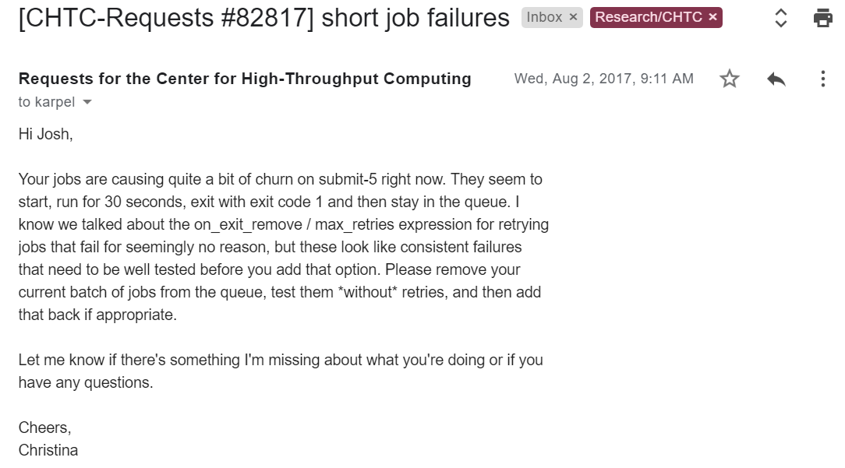
Automatic Retries

Slide 8
Automatic Retries
I use Cython
Cython needs GCC
Sometimes GCC isn’t available
My jobs explode and clog things up wait patiently to try again
I get yelled at
My jobs finish (eventually)
on_exit_hold = (ExitCode =!= 0)
periodic_release = (JobStatus == 5) && (HoldReasonCode == 3) && (CurrentTime - EnteredCurrentStatus >= 300) && (NumJobCompletions <= 10)

Slide 9
Your jobs will fail sometimes,
for reasons that you can’t solve
Make sure your jobs fail politely (don’t retry forever)
Don’t give up on your jobs (max_retries, etc.)
Tell people about your problems!
(Nuclear Option: Docker/Singularity)

Slide 10
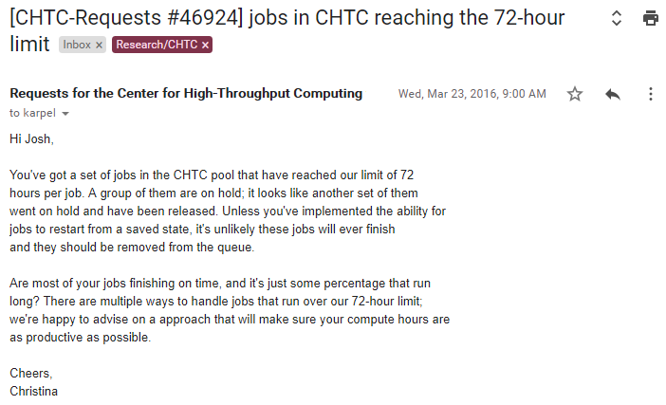
Self-Checkpointing Jobs

Slide 11
Self-Checkpointing Jobs
# Python-ish pseudocode
def run_simulation():
last_checkpoint = now
done = False
while not done:
advance_simulation()
if (now – last_checkpoint) > time_between_checkpoints:
do_checkpoint()
done = True

Slide 12
Self-Checkpointing Jobs
# Python-ish pseudocode
def execute_node():
try: simulation = find_existing_simulation() except FileNotFoundError: inputs = load_inputs() simulation = Simulation(inputs) simulation.run_simulation()
If you represent your job as an object,
it (usually) becomes easy to save it to disk
I use pickle, part of the Python standard library
The thing to look up is serialization

Slide 13
My Workflow
The smoother you can make this part work, the happier you’ll be
Generate input parameters
Submit job
Wait… read a book… er, paper…
Jobs are running…
Failed jobs are re-running automatically…
Evicted jobs aren’t failing…
Check Results
Do Science to Results
This is the part you can’t control, but have to interact with

Slide 14
Leverage HTCondor built-ins
to solve your problems
(Late Materialization is coming soon!)
Don’t be afraid to write your own solution!
(I gave a talk at HTCondor Week 2018 about my workflow)
HTC involves a different mindset,
with new problems and new tools

